Slide 1

PROJECT DARWIN
Team Blueprint
Yashasvi Misra
Shushrut Sharma
Siddhant Thakur
Mihir Singh

Slide 2
Introduction
A prototype of a platform which can help streamline and scale up the hiring process by automating the steps of recruitment.

Slide 3
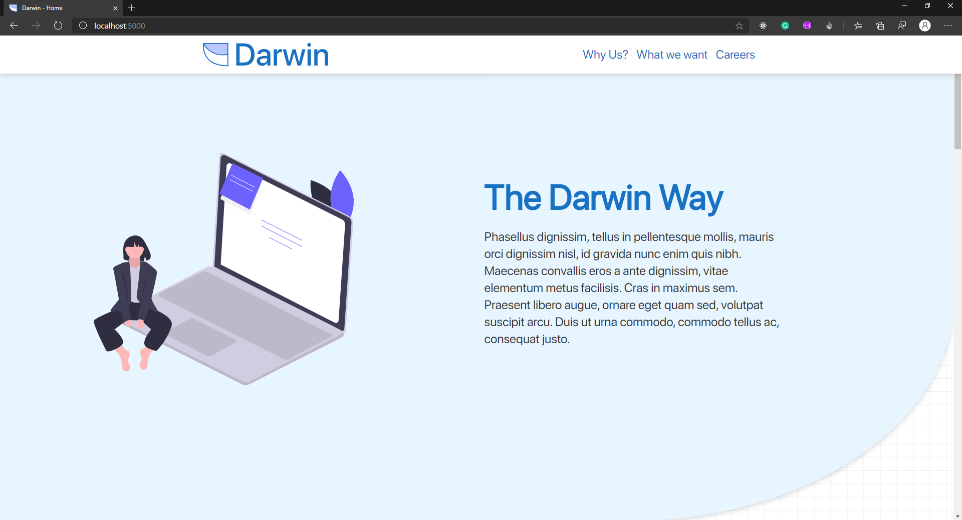
Landing Page

Slide 4
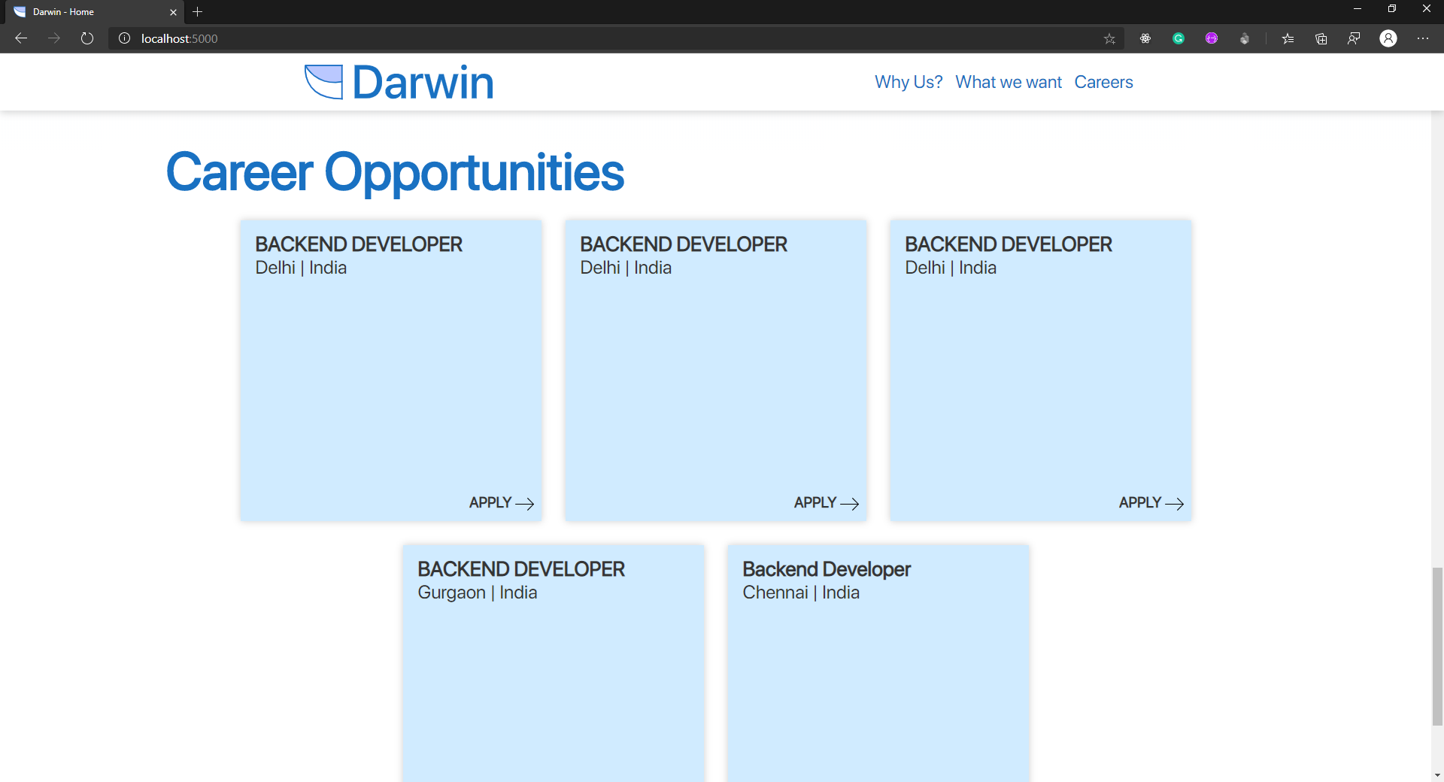
Public Job Listings

Slide 5
Chatbot
The chatbot collects contact and other details about the candidate.
The candidate is also allowed to upload their resume at the end of the interview.
An aptitude test is incorporated in the interview.

Slide 6
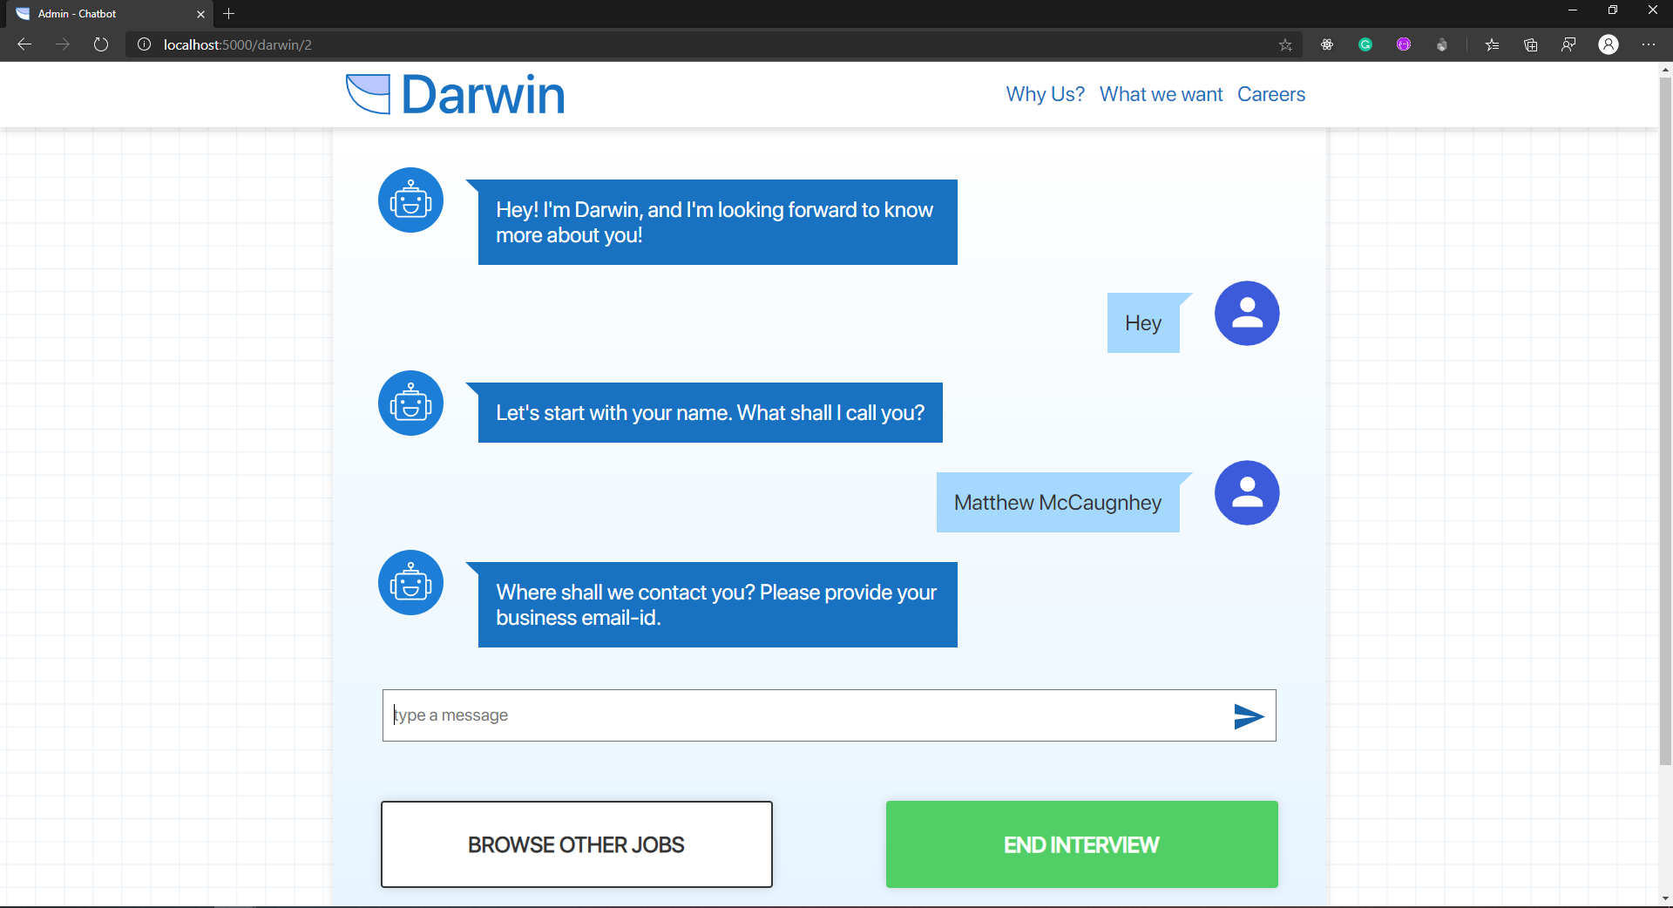
Chatbot

Slide 7
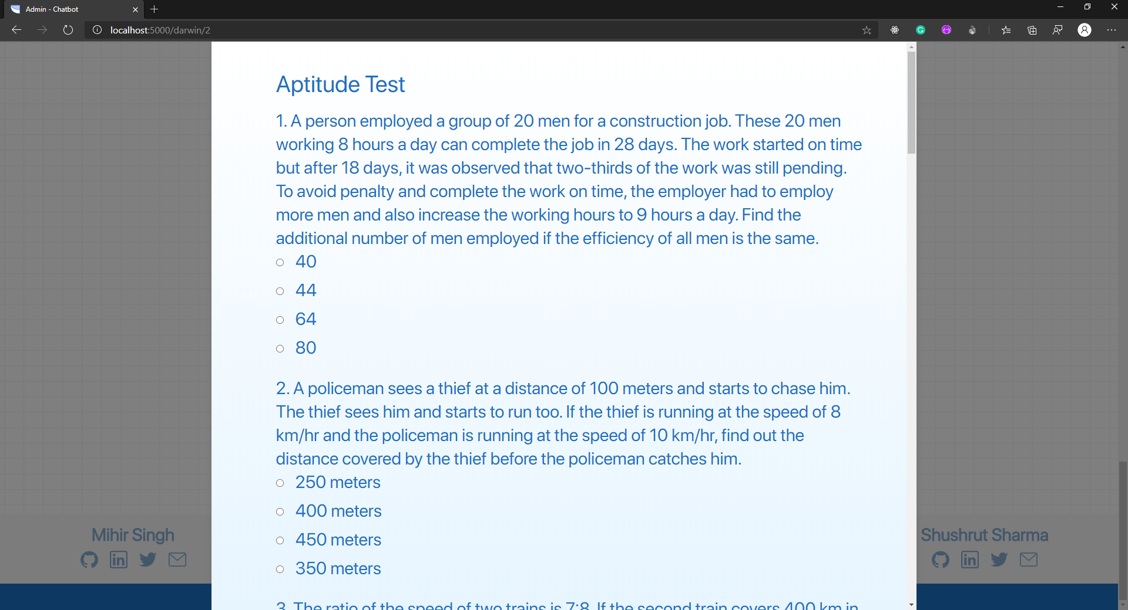
Aptitude Test

Slide 8
Admin Side
Through a secure login the hiring team have access to a portal where they can manage all job listings.
Through this portal they can also monitor applicants for a given job.
New job listings can be posted through the same.

Slide 9
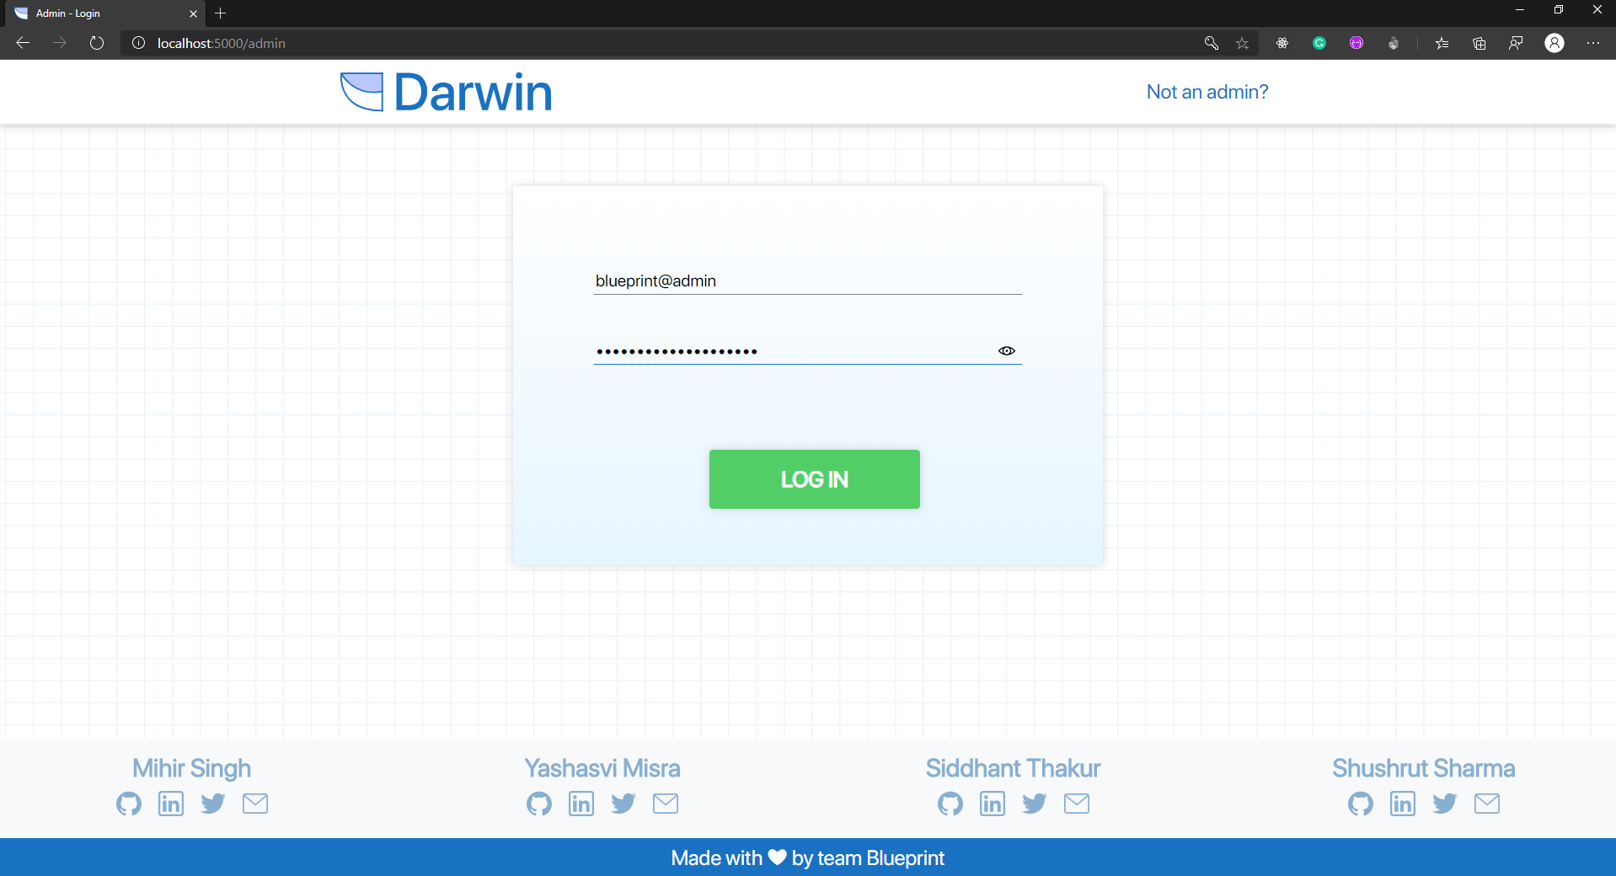
Admin Login

Slide 10
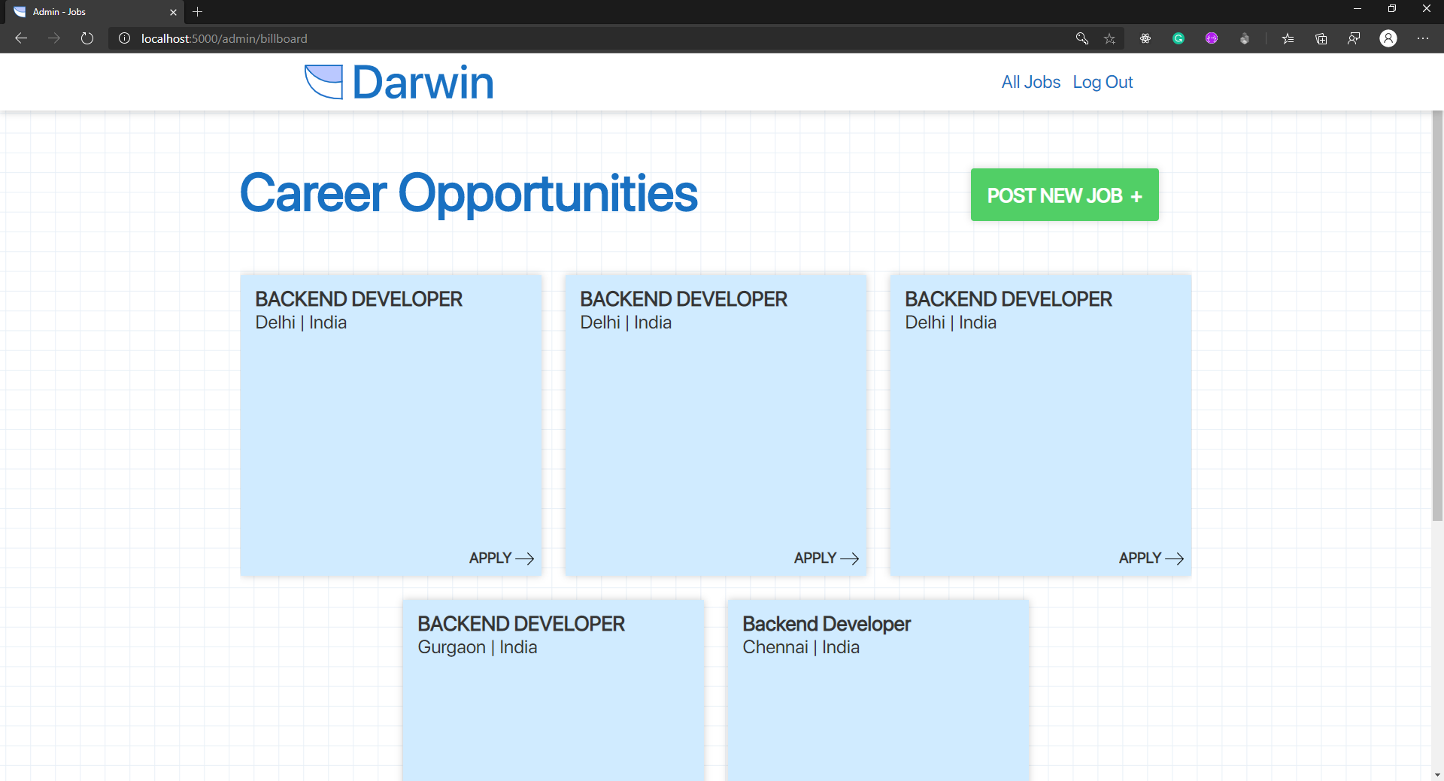
Job Listings

Slide 11
Applicant Details
Details of all applicants including their name, email, overall score and their resume are listed in rank of their suitability for the job.
The hiring team also has access to a dashboard to provide insights into the candidate pool through visualizations.

Slide 12
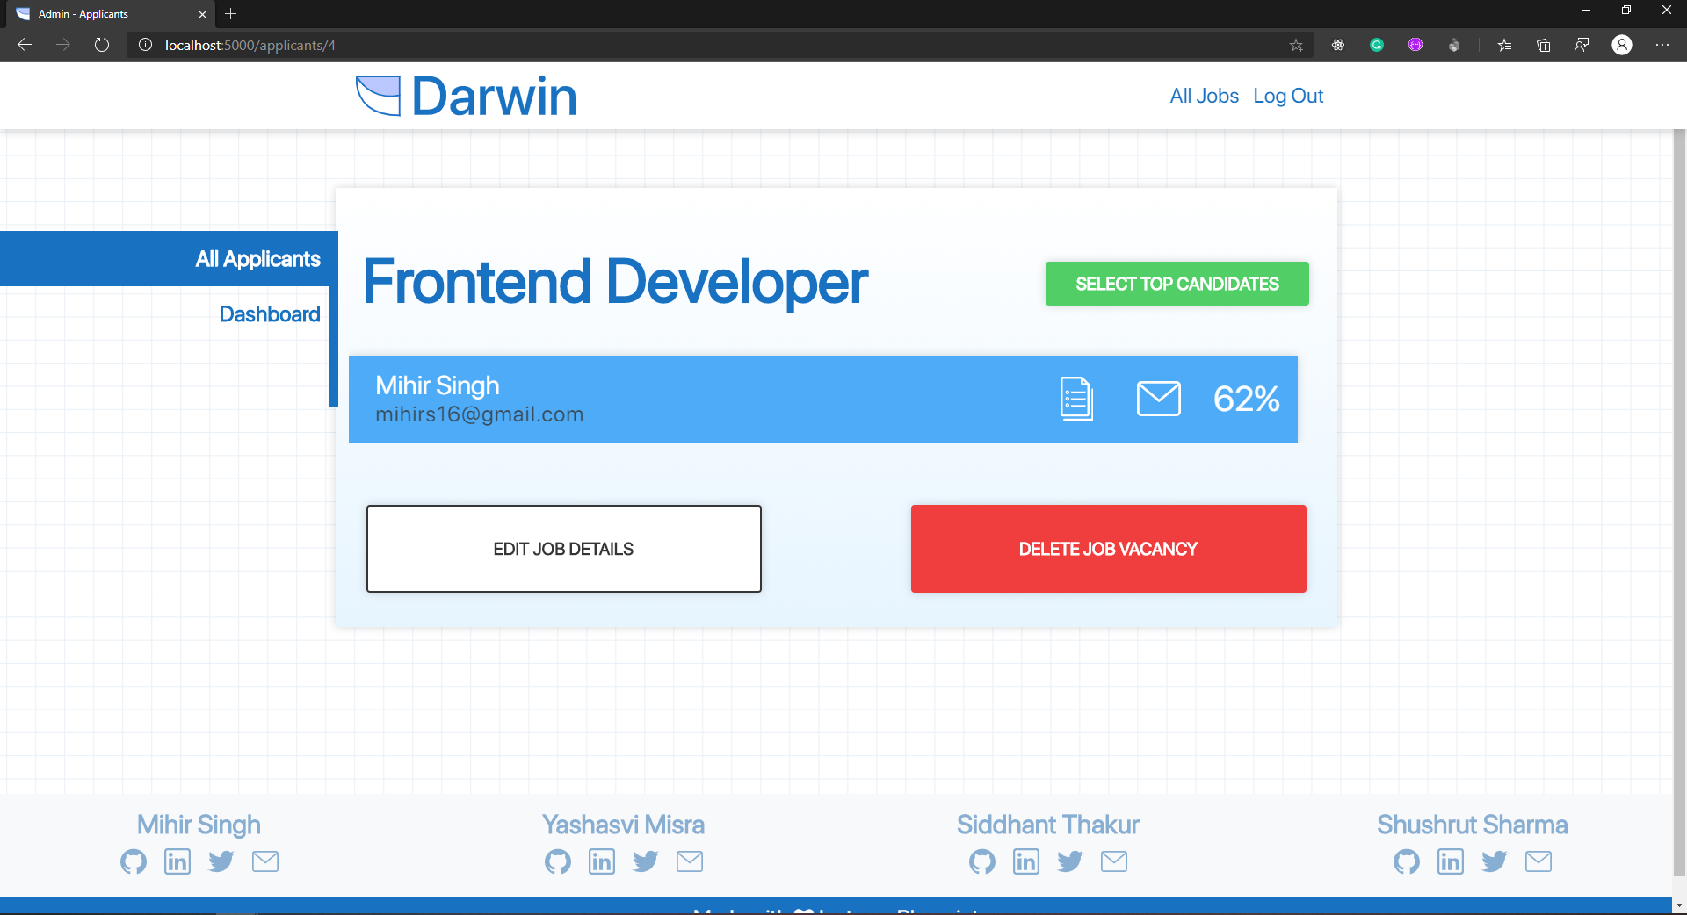
All Applicants

Slide 13
Add New Job
The hiring team can post new jobs through the portal.
They can specify values for criterion that are judged in order to calculate the over all score of a candidate.
They can also specify multiplier values which lets them adjust the weight imposed by a particular criteria or choose to set the weight to zero in which case that specific criteria wouldn’t be considered.

Slide 14
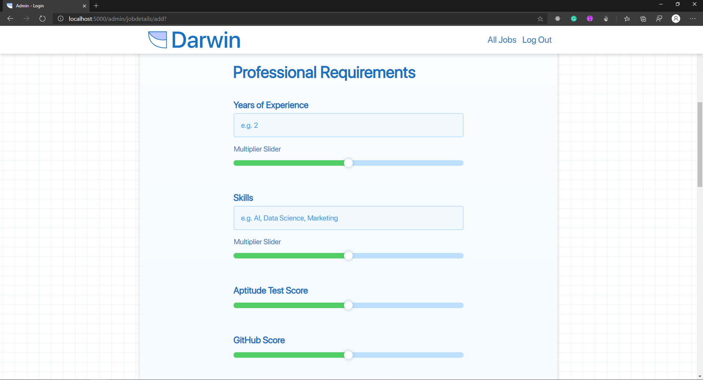
Add New Job

Slide 15
Advantages
More efficient hiring process.
Less labor required to carry out recruitments.
Recruitment campaigns of a larger scale with greater ease.
Streamlined recruiting process with every action available through a one-stop platform.

Slide 16
Disadvantages
Being judged by a machine might not be favorable to candidates.
The platform has loopholes such as the event of absence of a social account on twitter.
The platform cannot directly replace the interview process, but augment it as a preliminary filter.

Slide 17
Applications
Large scale recruitments augmented through filtration.
Smaller scale recruitments streamlined with increased efficiency.
A unique use-case can also be covered by minimal tuning to implement the same platform to judge current employees and rank them against each other.

Slide 18
Future Scope
The chatbot could be enhanced to ask more questions with deeper insights.
The aptitude test can be made more comprehensive with a larger question bank.
The platform could be made more robust by allowing sign up and registration of candidates and multiple companies.

Slide 19
Thank You

